Slide 1
Intro to Data Structures in Python
Presenter: PopAi AI Creation

Slide 2

Content
1. Understanding Data Structures
2. Data Structures in Python

Slide 3

Understanding Data Structures
Section 1

Slide 4




What Are Data Structures?
Efficient Data Organization
Data structures are a way of organizing data to enable efficient access and manipulation based on specific requirements.
Fundamental Constructs
They are fundamental constructs that provide different ways of organizing and storing data to suit various programming needs.
Enhanced Efficiency
Proper use of data structures can significantly enhance the efficiency of data access and manipulation.
01
02
03

Slide 5
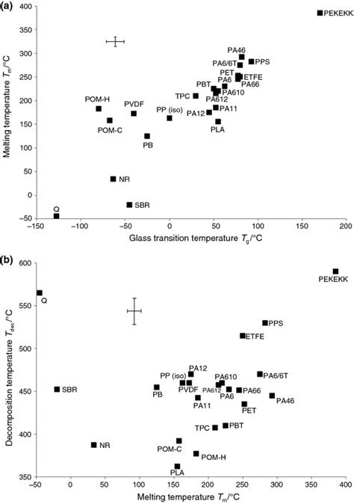

Types of Data Structures
Lists
Lists are ordered, mutable, and can contain elements of different data types, making them versatile for various data storage needs.
Tuples
Tuples are ordered, immutable, and can store a sequence of elements, often used for fixed collections of items.
Dictionaries
Dictionaries are unordered, mutable, and store data in key-value pairs, allowing for efficient data retrieval based on keys.

Slide 6
Importance of Data Structures
Efficiency
Data structures enable efficient data storage, retrieval, and manipulation, optimizing program performance.
Flexibility
They provide flexibility in handling different types of data and performing various operations on the data.
Scalability
Proper use of data structures ensures that programs can scale effectively to handle larger datasets and complex operations.
01
02
03

Slide 7
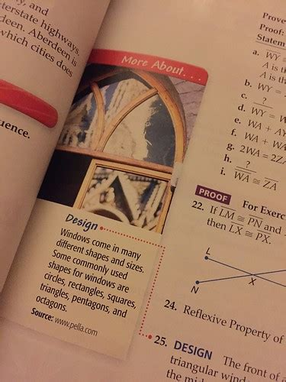
Real-World Applications
Database Management
Data structures are crucial for organizing and accessing data in databases efficiently.
Algorithm Design
Many algorithms rely on specific data structures for optimal performance and functionality.
System Design
Data structures play a vital role in designing efficient and scalable software systems.

Slide 8

Data Structures in Python
Section 2

Slide 9


Lists in Python
Versatile Data Storage
Lists in Python are ordered and mutable, allowing for the storage of elements of different data types in a single container.
Dynamic Operations
They support dynamic operations like appending, removing, and slicing elements, making them highly flexible for various tasks.
01
02

Slide 10




Tuples in Python
Immutable Sequences
Tuples in Python are ordered and immutable, making them suitable for representing fixed collections of elements that should not be changed.
Efficient Data Protection
Their immutability ensures that the data they contain remains unchanged, providing data integrity in certain scenarios.
01
02

Slide 11









Dictionaries in Python
Key-Value Pairing
Dictionaries in Python are unordered and mutable, allowing for efficient storage and retrieval of data through key-value associations.
Fast Data Lookup
They provide fast lookup times for accessing values based on their associated keys, making them ideal for tasks like indexing and mapping.
01
02

Slide 12
Sets in Python
Unique Element Storage
Sets in Python are unordered and mutable collections that store unique elements, making them useful for tasks like removing duplicates from a sequence.
Efficient Data Deduplication
They provide an efficient way to eliminate duplicate elements from other data structures like lists or tuples.
01
02

Slide 13
Thank You

